Slide 1

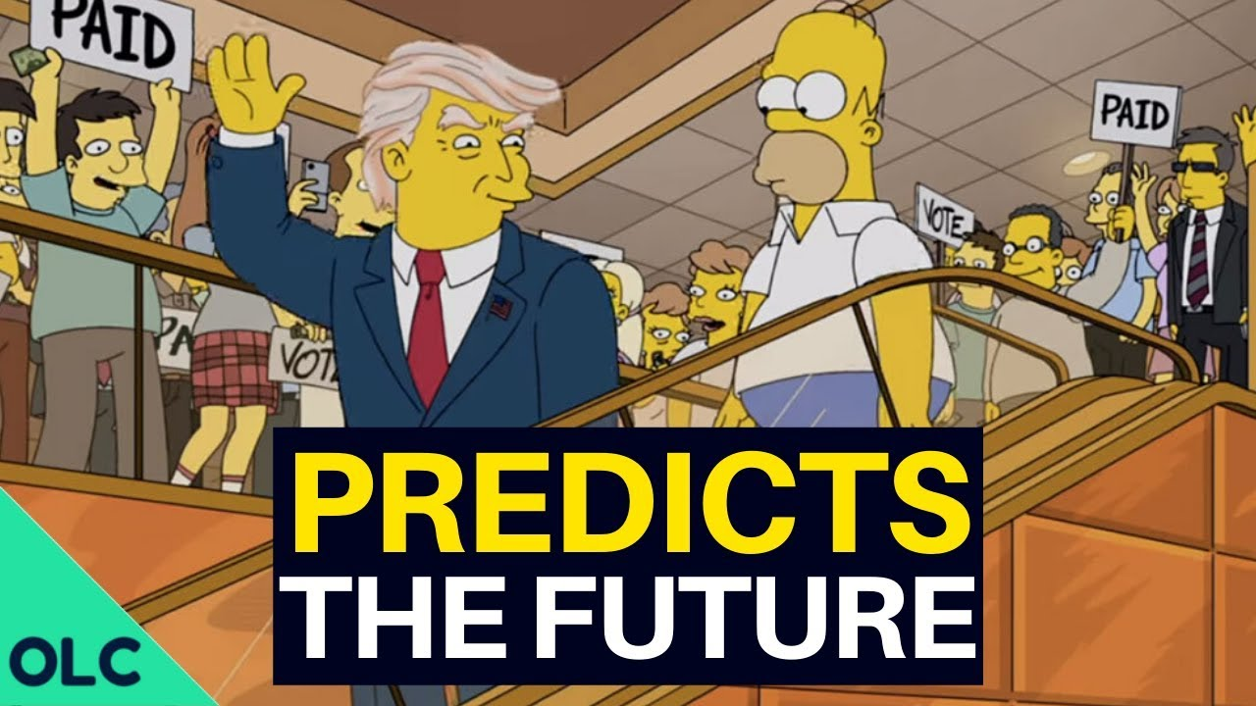
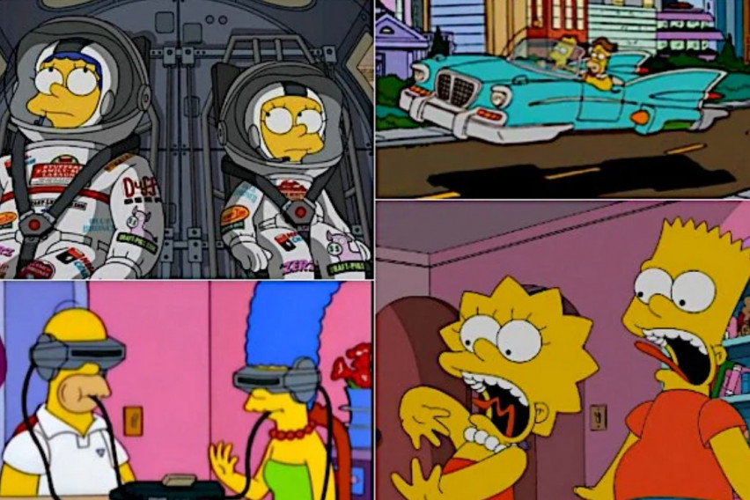
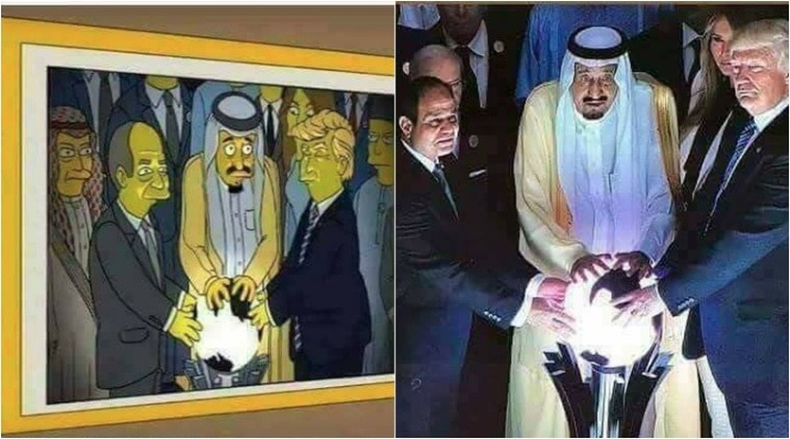
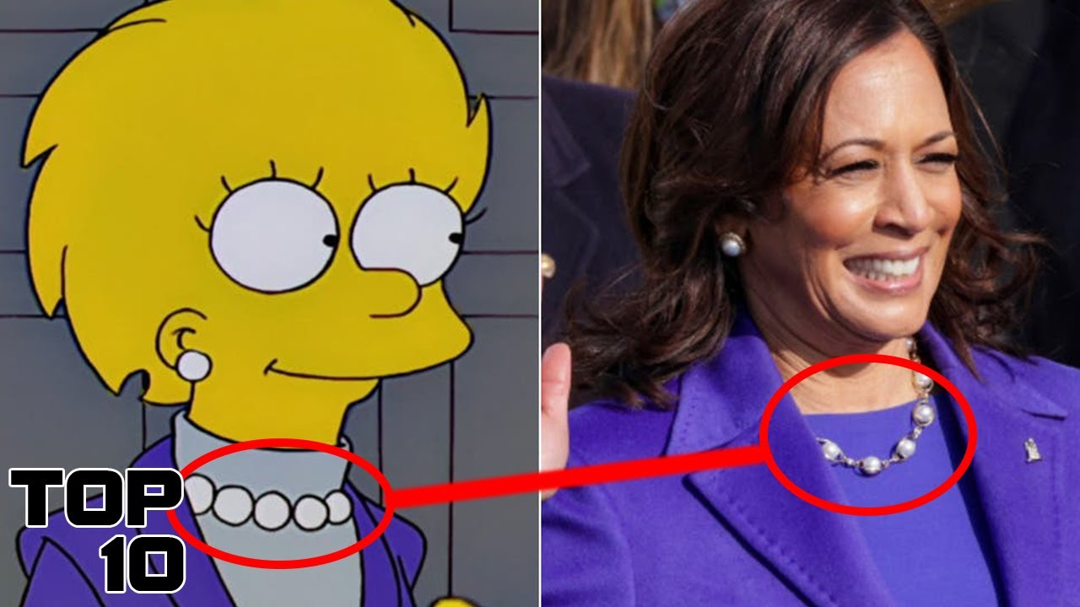
The Simpsons predict the future!

Slide 2
What are we going to talk about?
“Simpsons did it again”. We'll talk about what events the Simpsons predicted.
02
Let's find out what a conspiracy theory is and why the Simpsons have become so much discussed?
01
“IT WASN’T IN THE SIMPSONS”. We will destroy the myths about predictions and summarize our own, impartial results.
03

Slide 3
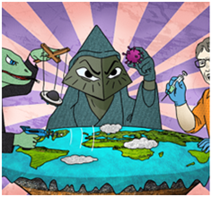

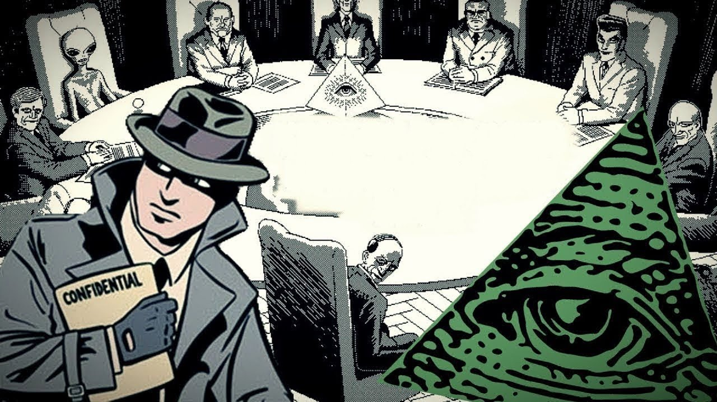
Conspiracy theories
As many probably know, a conspiracy theory is defined as a theory that rejects the standard explanation for an event and instead credits a covert group or organization with carrying out a secret plot.
Conspiracy theories have come up throughout history, and some people are more likely to believe them than others. The damage caused by the perpetuation of misinformation can have serious social consequences.

Slide 4
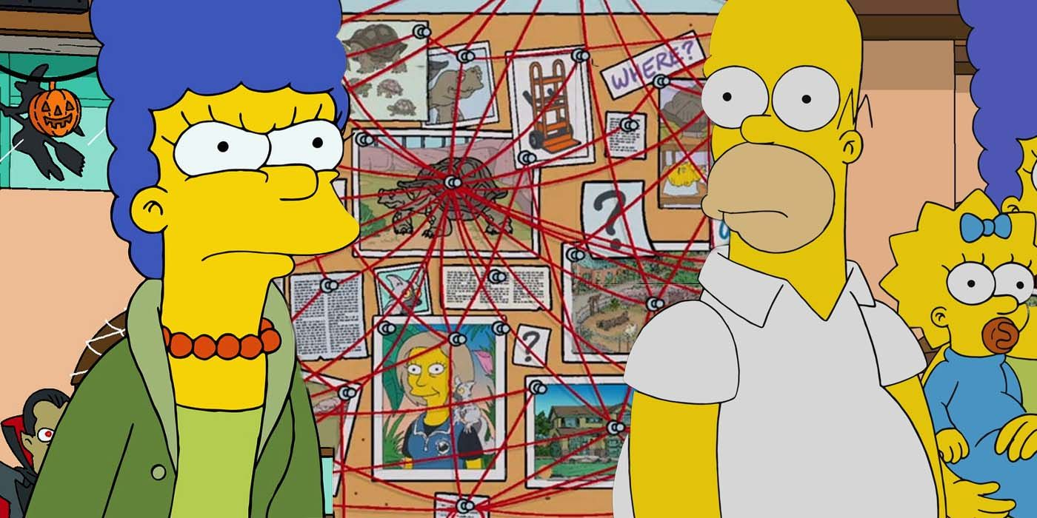
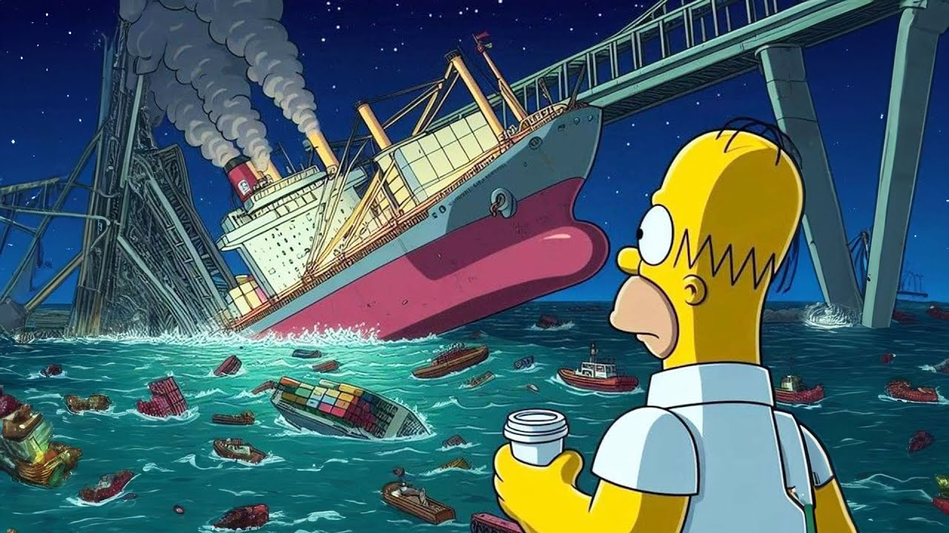
The Simpsons
Fans of The Simpsons have long noticed that many of the brightest events in the animated series were repeated in real life.
No project has such a large number of "hits": from the first Apple Watch to the unknown Chinese virus, which has been so fiercely discussed recently.
Creator Matt Groening clearly knows something…

Slide 5
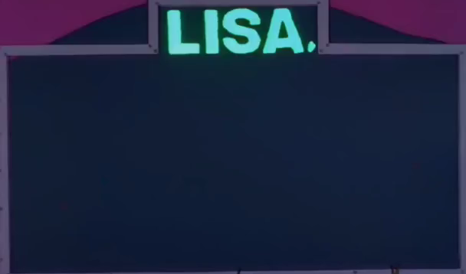
APPLE WATCH
In 1995, an episode called "Lisa's Wedding" was released, in which the creators showed the very first smart watch. Who would have thought that already in 2014, Apple announces the Apple Watch with the same idea as in the Simpsons.
Release: 1995 When it came true: 2014
«Lisa's Wedding»
episode 19, season 6

Slide 6
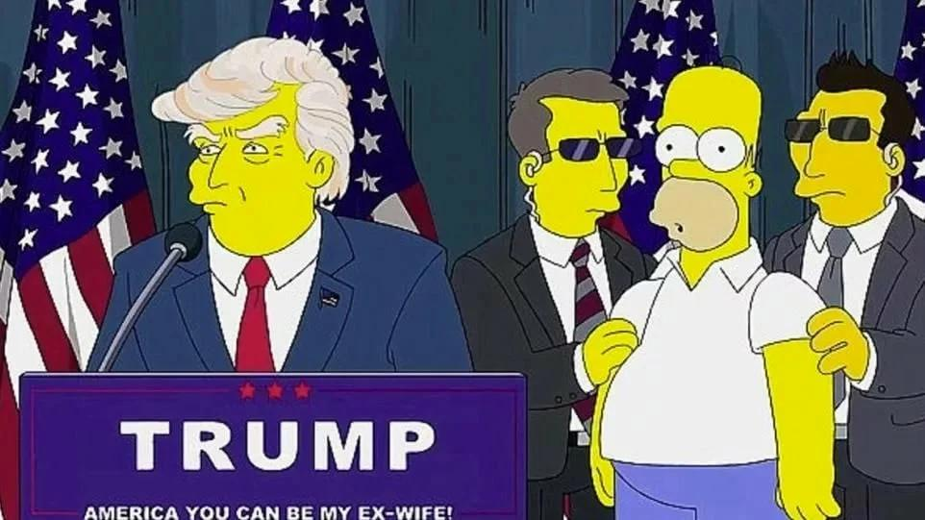
DONALD TRUMP
There is another popular theory that The Simpsons predicted that Donald Trump would become President of the United States. Fragments of the episode with Trump on the escalator, which was expected back in 2000 and opened up the future, went viral.
Release: 2000 When it came true: 2016
«Bart to the Future»
episode 17, season 11

Slide 7
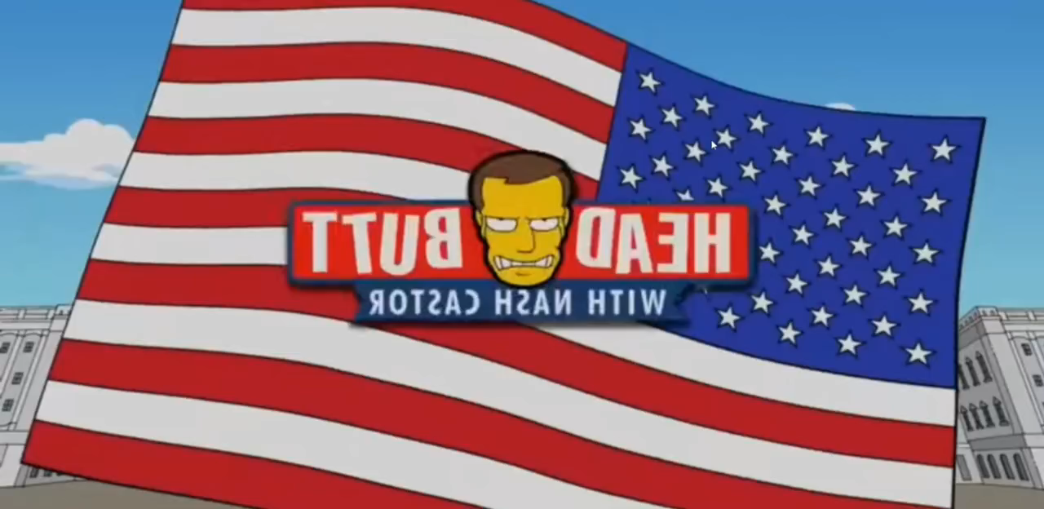
GREECE’S ECONOMIC CRISIS
A ticker in the news release when Homer appeared in it indicated that Europe had put Greece on eBay. As a result, Greece was really hit by a severe economic crisis, and the European Union refused to repay the country's debts.
Release: 2012 When it came true: 2015
«Political Bunglers with Homer Simpson»
episode 23, season 10

Slide 8
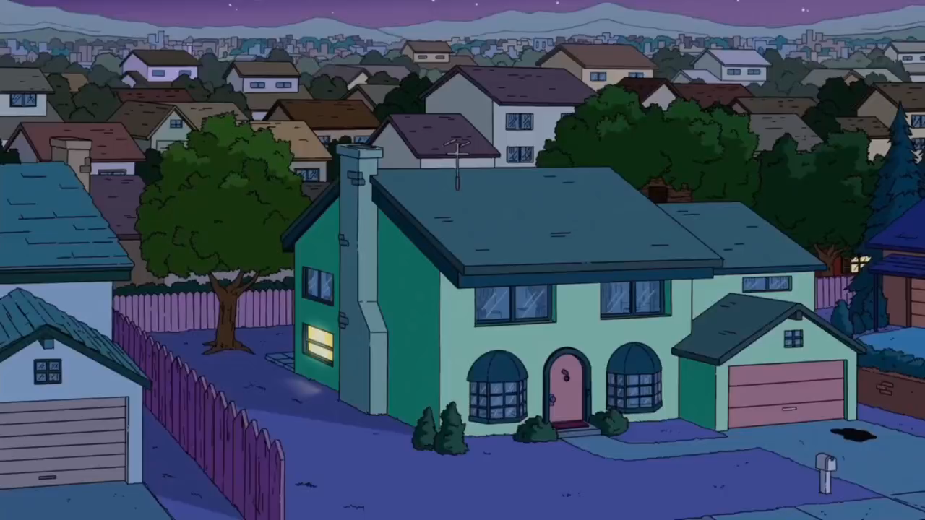
BENGT HOLMSTRÖM NOBEL PRIZE
In 2010, the Simpsons showed a series where the famous economist Bengt Holstrom was considered one of the favorites to receive the Nobel Prize. Six years later, that prediction came true.
Release: 2010 When it came true: 2016
«Elementary School Musical»
episode 22, season 1

Slide 9
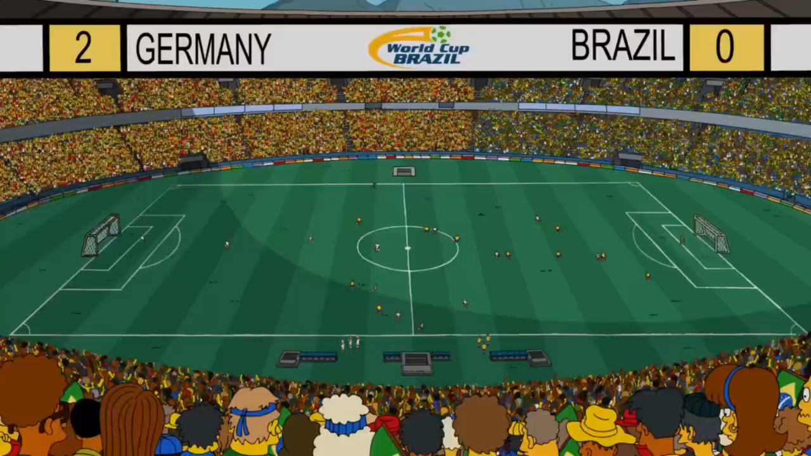
GERMANY BEAT BRAZIL IN THE WORLD CUP
In this episode, Homer Simpson becomes a referee at the FIFA World Cup in Brazil. That in the cartoon, that in reality Brazil lost to Germany.
Release: March 2014 When it came true: July 2014
«You don't have to live like a referee»
episode 25, season 16

Slide 10

ATTACK ON THE TWIN TOWERS
In this episode, Bart stands next to a magazine advertising $9 tickets against the backdrop of the twin Towers. Together they form the date 9.11. In addition, Lisa gets a triangle of hair, which many researchers associate with the pyramid of the All-seeing Eye. And in Bart's hand is a bill with a symbol that looks like Freemason money.
Release: 1997 When it came true: 2001
«New York vs. Homer Simpson»
episode 9, season 1

Slide 11
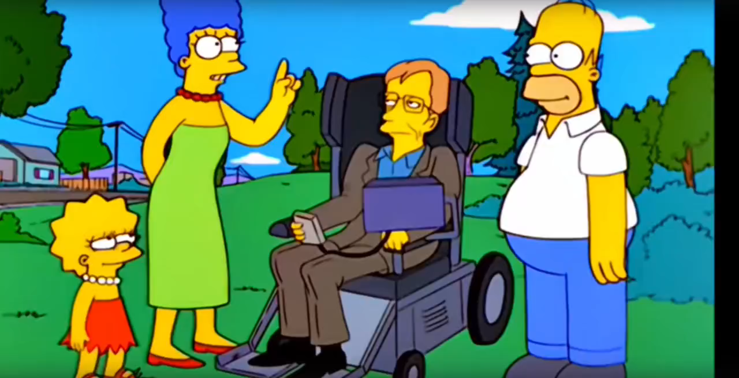
THE DONUT-SHAPED UNIVERSE
In 1999, the scientist Stephen Hawking tells Homer about the "vast" universe. He described it as a doughnut. In 2003, scientists using the WMAP spacecraft obtained data on the microwave background of space left in the universe after the Big Bang. Describing the theoretical shape of a closed universe, they said that it looks like a circle with a hole in the center.
Release: 1999 When it came true: 2003
«They Saved Lisa's Brain»
episode 22, season 10

Slide 12
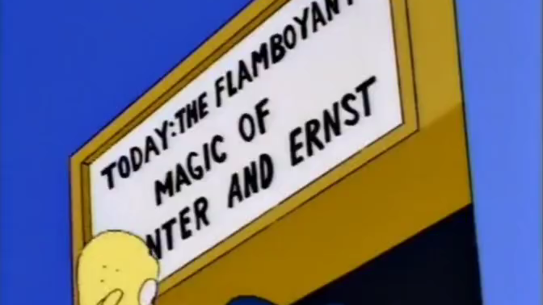
WHITE TIGER ATTACK ON ROY HORN
Springfield legalized gambling, and Mr. Burns opened a casino. It featured animal trainers Gunther and Ernst, who parodied Siegfried Fischbacher and Roy Horn's performances in Las Vegas. During the performance, a white tiger attacked one of the trainers. In reality, Horn was attacked by a seven-year-old white Bengal tiger named Montecor.
Release: 1993 When it came true: 2003
«Steve Pringfield»
episode 5, season 10

Slide 13
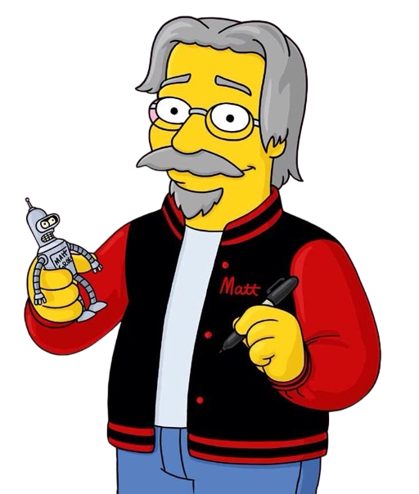
How do they do it?
«The Simpsons' predictions can be explained by a basic understanding of history and mathematics. If you immerse yourself in history, you can "predict" the future because humanity repeats itself. If you dig into the math, you'll realize that statistically, with 1,000 jokes over almost 800 episodes, it's impossible not to guess what will happen in real life. But people prefer to answer simply: “It’s magic”»
© Matt Groening

Slide 14
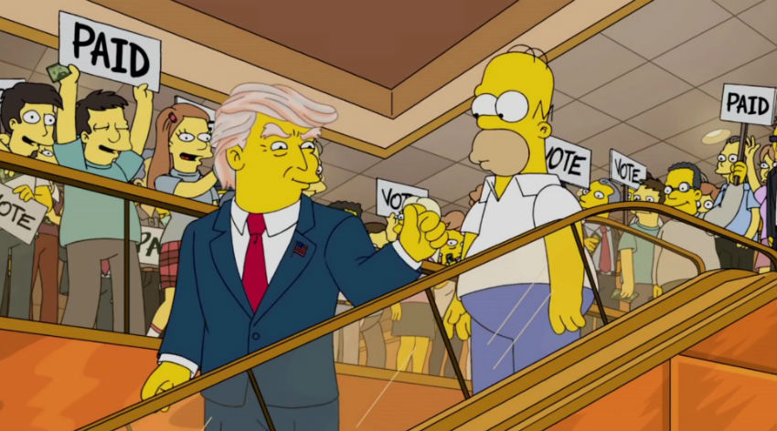
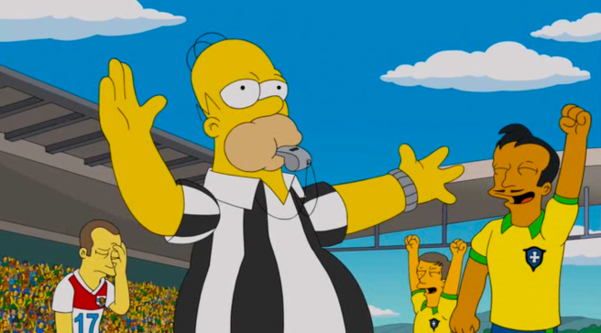
One of the screenwriters said that they did not predict Trump's presidency, but vice versa. The businessman was chosen as the most unlikely candidate for the presidency in order to bring the situation to the point of absurdity.
Simpson referees a match between Brazil and Germany, and the founders of football unexpectedly lose - this is what happened in reality. True, in the cartoon the Germans won with a score of 2:0, but in reality they defeated their opponents, scoring seven goals.

Slide 15
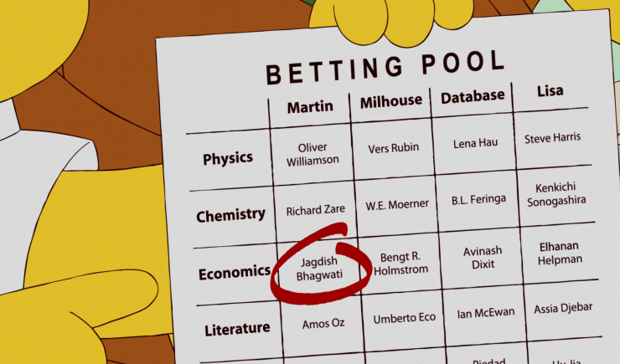
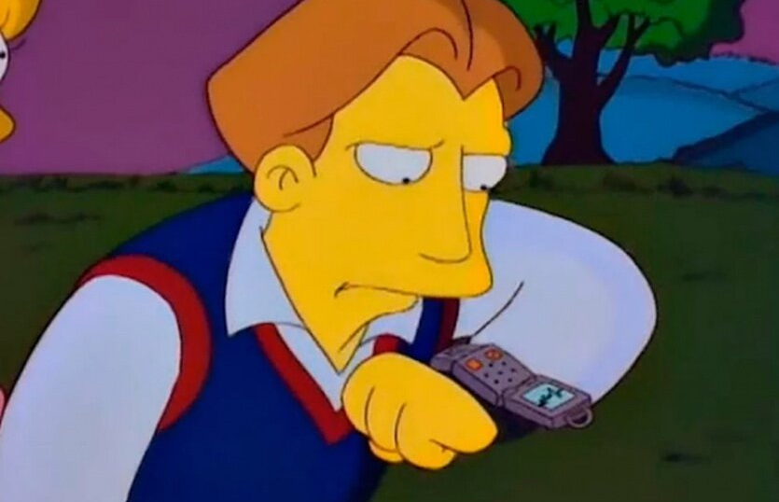
As for the Nobel Prize winner Bengt Holmström, in fact, the “predictions” from “The Simpsons” have no statute of limitations, so by listing a number of outstanding scientists, politicians and writers, sooner or later you will come up with future winners.
The idea of ​​a smartwatch is actually very commonplace and easy to predict. They are found in many science fiction works. There is no trick in this.

Slide 16
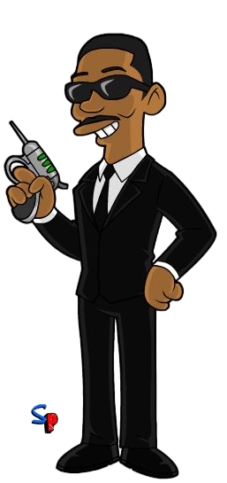
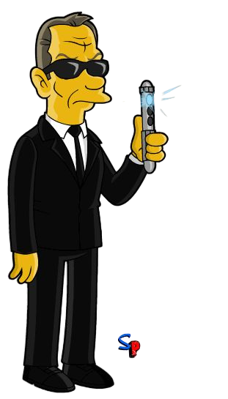
The Simpsons definitely DO NOT predict the future.
No.
Trufanov
Nope.
Merkulova

